Slide 1




Python - String va uning metodlari

Slide 2
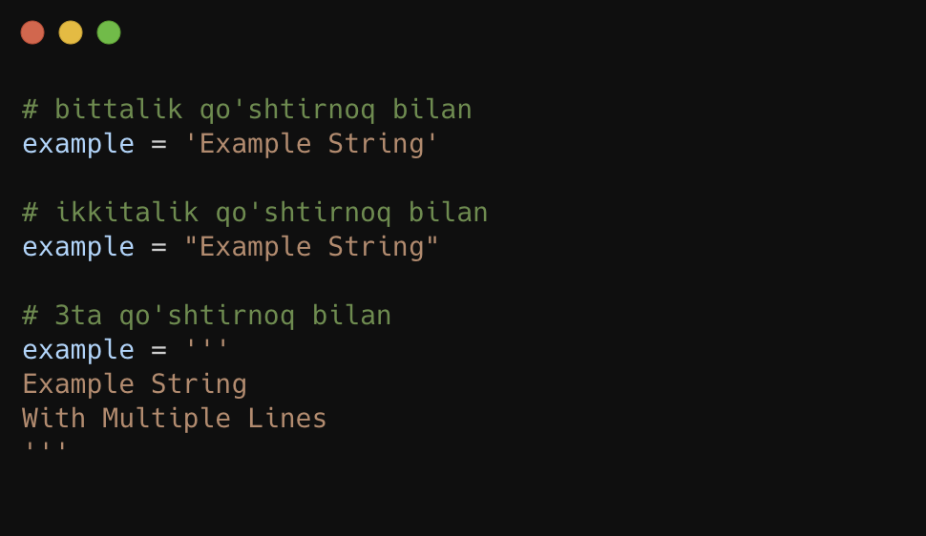
String - matn ma’lumot turi

Slide 3
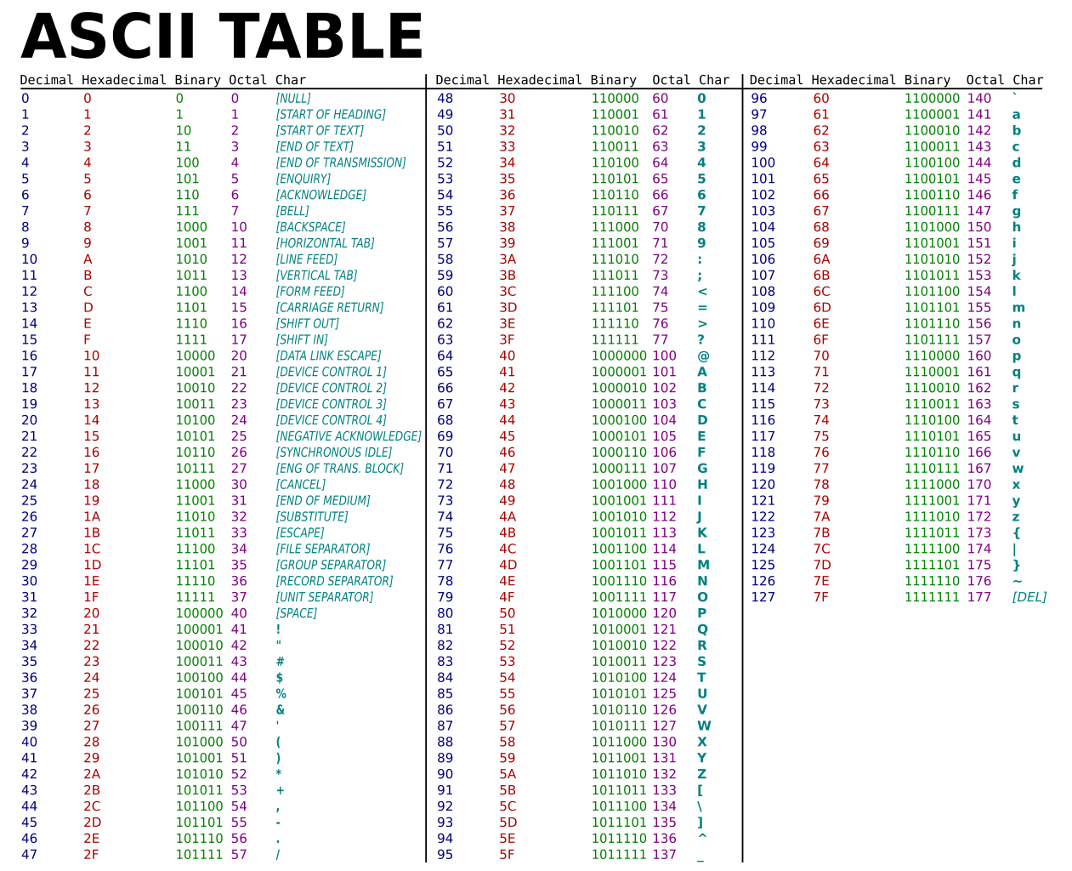

Slide 4
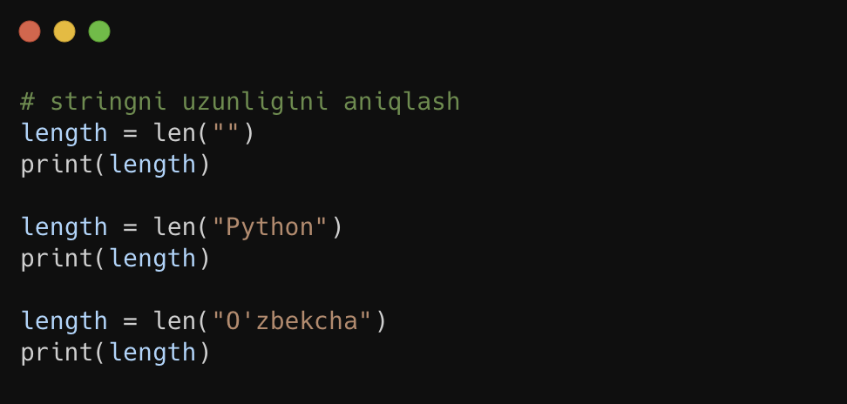
String Uzunligini Aniqlash

Slide 5
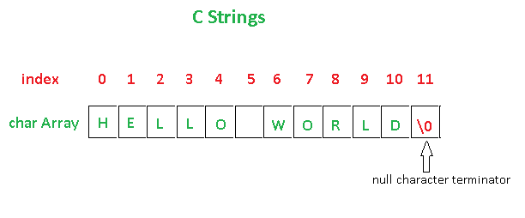

Slide 6
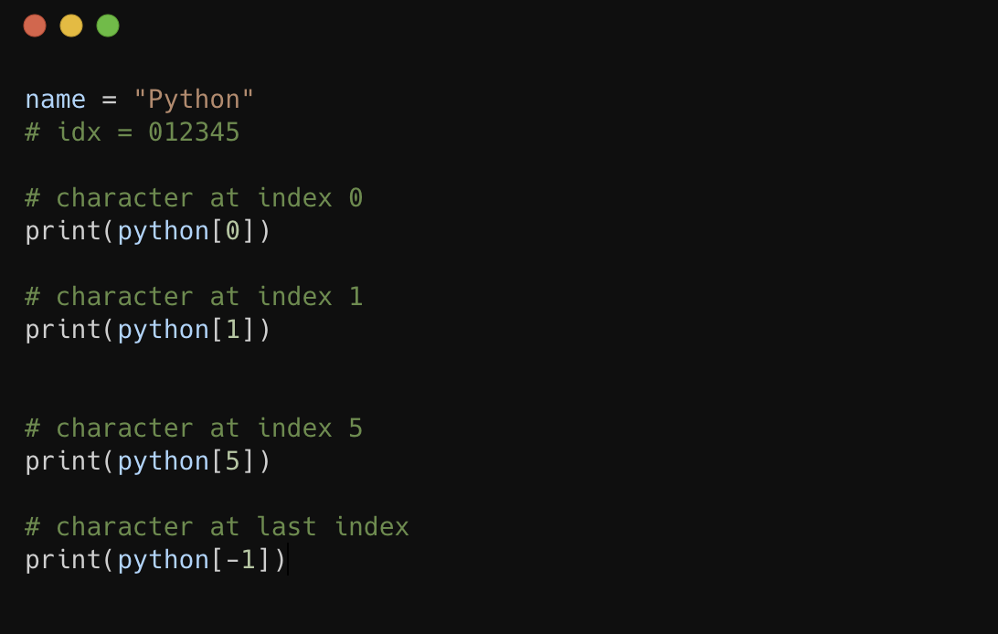
String Indexing

Slide 7
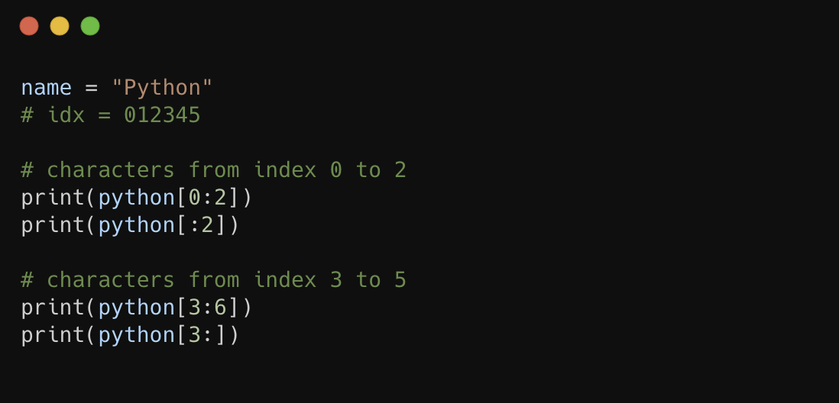
String Slicing

Slide 8
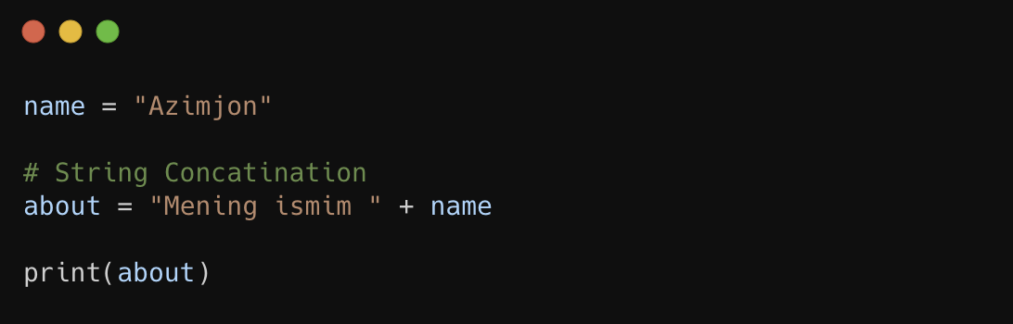
String Concatenation

Slide 9
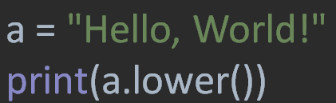
lower() – barcha harflarni kichigiga almashtiradi

Slide 10
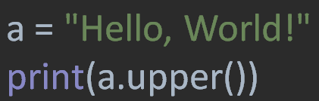
upper() – barcha harflarni kattasiga almashtiradi

Slide 11
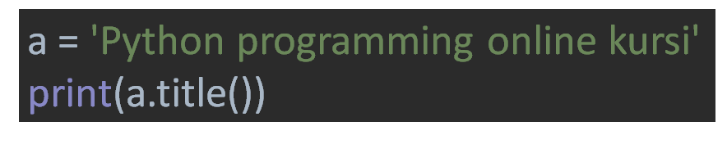
title() – barcha so’zlarning birinchi harfini katta qiladi

Slide 12
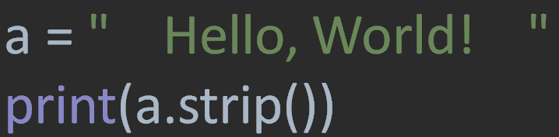
strip() – Stringni boshi va oxiridagi probel(bo’sh joy)larni o’chiradi

Slide 13
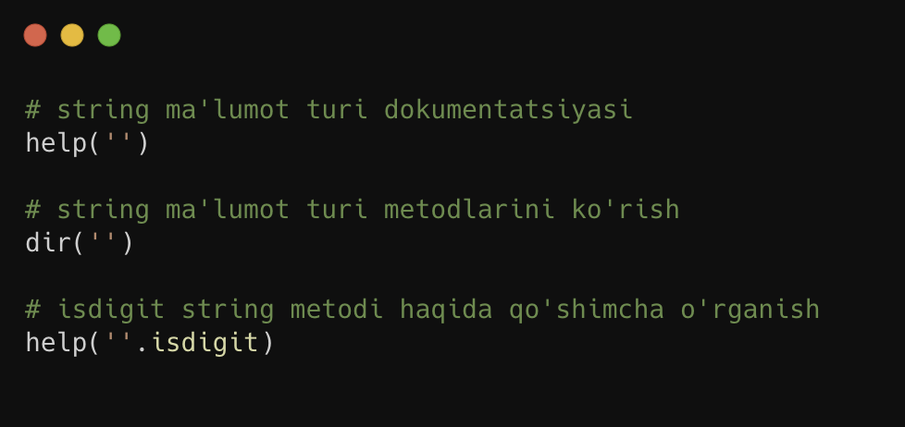
dir, help
orqali metodlarni aniqlash va o’rganish

Slide 14
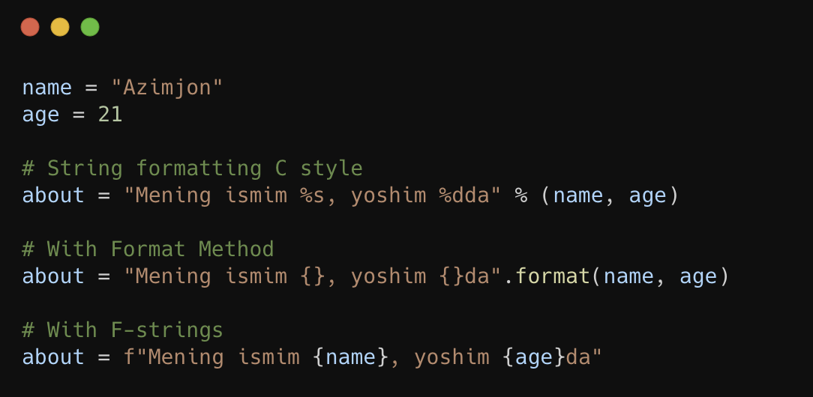
String Formatting

Slide 15
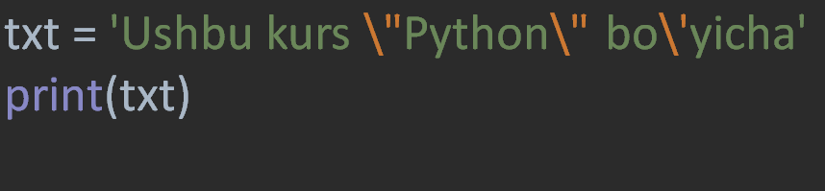
Escape Character
Code | Result
\' | Single Quote
\\ | Backslash
\n | New Line
\r | Carriage Return
\t | Tab
\b | Backspace
\f | Form Feed
\ooo | Octal value
\xhh | Hex value

